Slide 1
REGAL: Representation Learning-based Graph Alignment
Nicholas Gaubatz, Adrian Rushing, Niklas Schulmeyer

Slide 2
Introduction

Slide 3
Background
This paper comes from a research group at the University of Michigan.
Posted on arXiv in 2018.
See also the GitHub page https://github.com/GemsLab/REGAL.

Slide 4
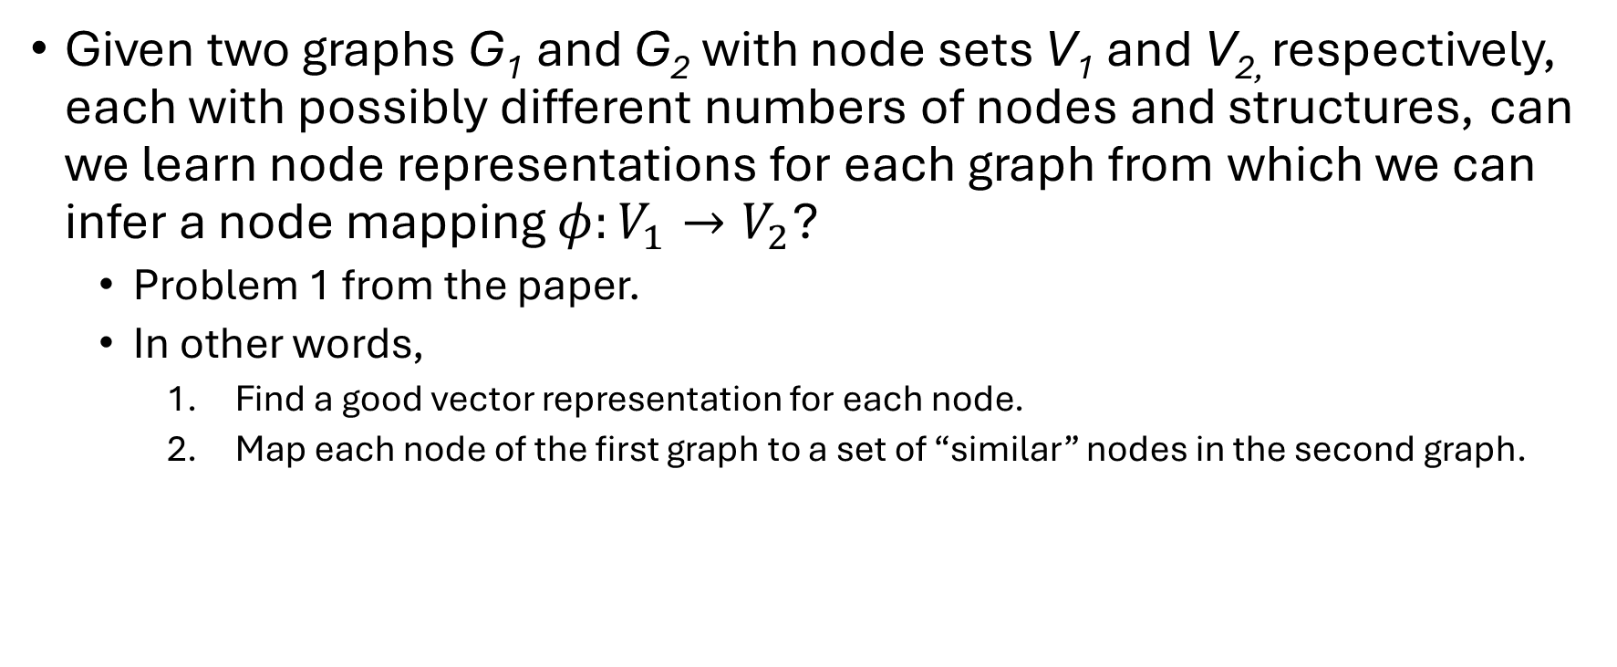
Context: Graph alignment
Given two graphs G₁ and G₂ with node sets V₁ and V_{2,} respectively, each with possibly different numbers of nodes and structures, can we learn node representations for each graph from which we can infer a node mapping $φ:V_{1}→V_{2}$?
Problem 1 from the paper.
In other words,
Find a good vector representation for each node.
Map each node of the first graph to a set of “similar” nodes in the second graph.

Slide 5
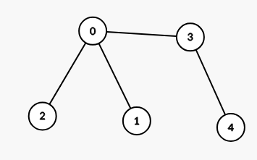
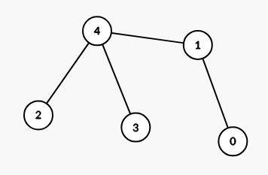
Small examples of node alignments
Isomorphic graphs below: mappings should reverse node order ($0→4, 1→3, …, 4→0$).
https://csacademy.com/app/graph_editor/ used to generate graph images throughout.

Slide 6
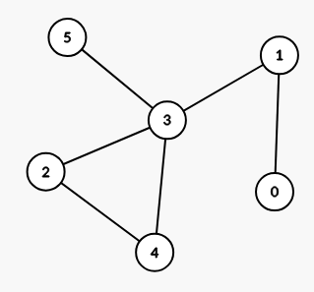
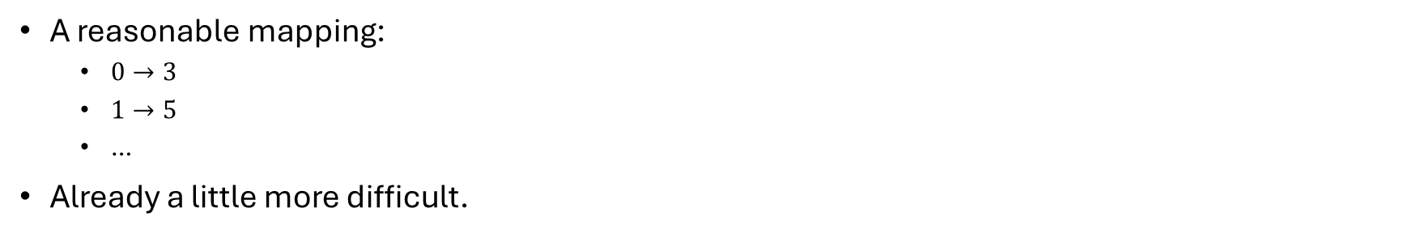
Small examples of node alignments (cont.)
A reasonable mapping:
$0→3$
$1→5$
…
Already a little more difficult.

Slide 7
Significance of graph alignment
What about aligning nodes in graphs with thousands or millions of nodes?
The paper mentions applications to:
Social network analysis
Chemistry and bioinformatics
E.g., protein interaction networks and brain networks
Pattern recognition

Slide 8
Algorithm overview

Slide 9
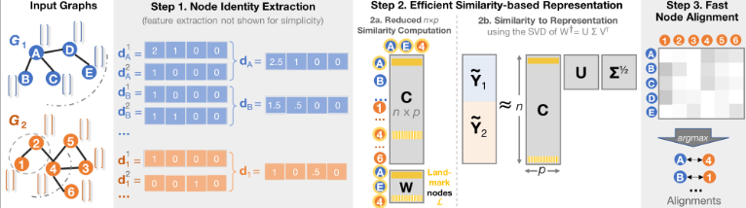
REGAL
REGAL is a 3-step process:
Node identity extraction
Efficient similarity-based representation
Fast node representation alignment
Steps 1 and 2 comprise their own new algorithm: xNetMF
Cross-network matrix factorization

Slide 10
Features and strengths
Can align more than two graphs
Does not use random walks to analyze node structure
Uses a low-rank approximation matrix, saving time and space

Slide 11
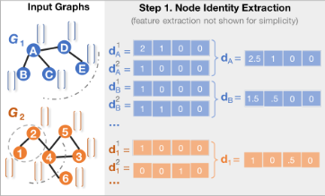
Step 1: node identity extraction
Input: adjacency matrices of graphs
Output: a feature matrix
Each node in the two graphs has a vector describing its structure within the graph.
Local structure: each node only has information about nodes k hops away.

Slide 12
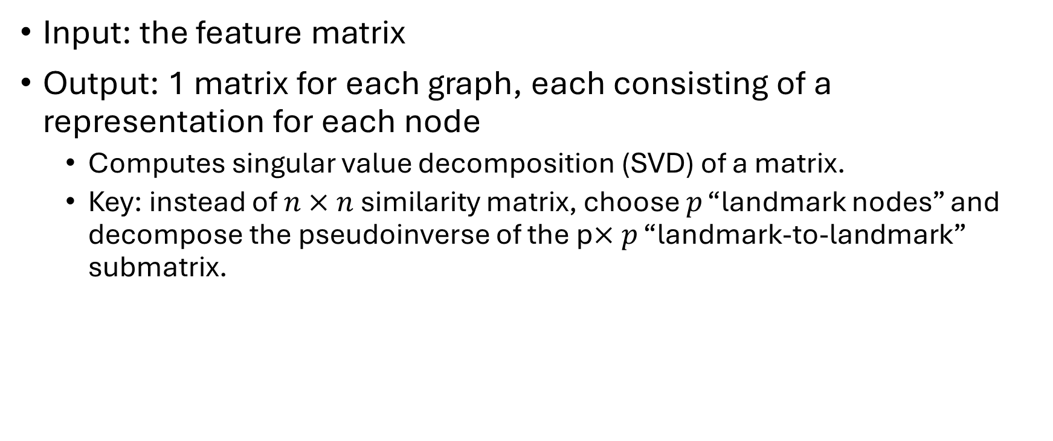
Step 2: Efficient similarity-based representation
Input: the feature matrix
Output: 1 matrix for each graph, each consisting of a representation for each node
Computes singular value decomposition (SVD) of a matrix.
Key: instead of $n×n$ similarity matrix, choose $p$ “landmark nodes” and decompose the pseudoinverse of the p$×p$ “landmark-to-landmark” submatrix.

Slide 13
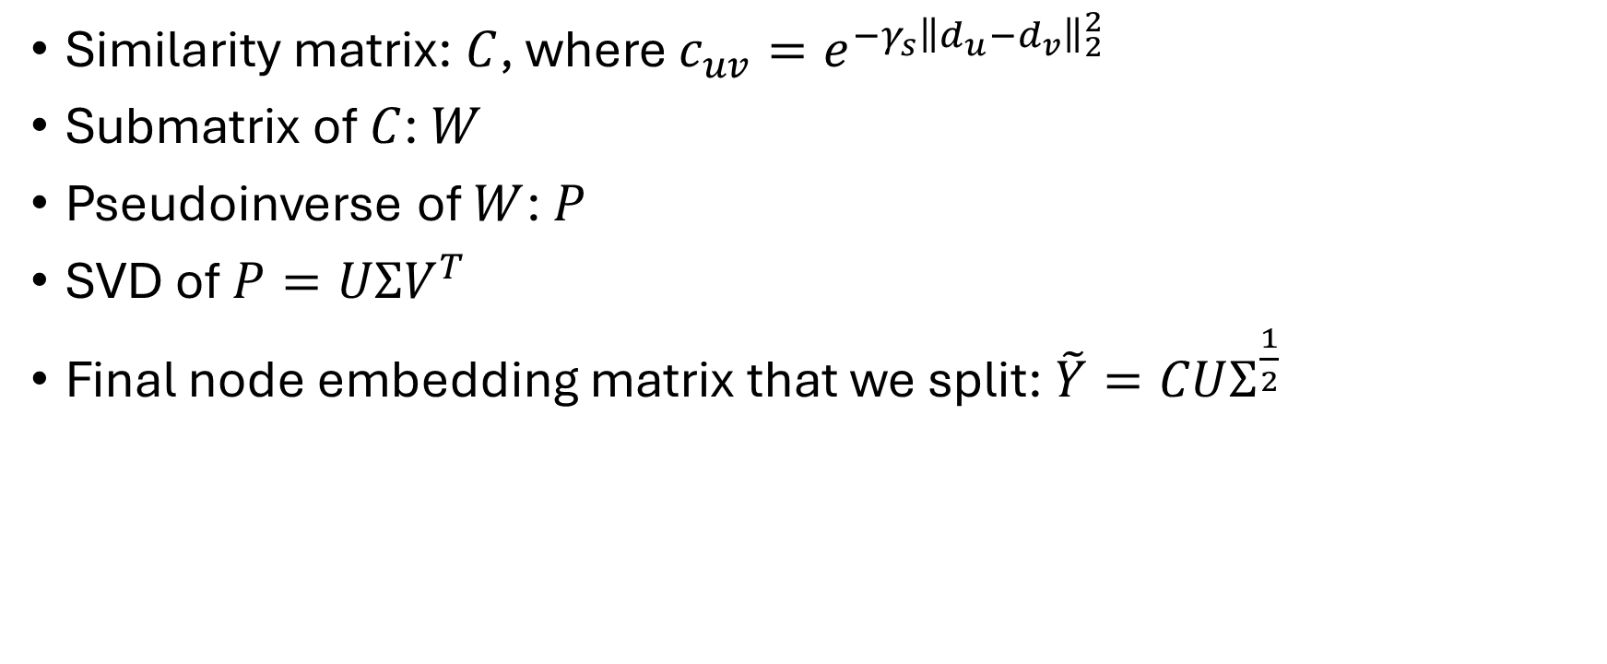
Step 2 (cont.)
Similarity matrix: $C$, where $c_{uv}=e^{−γ_{s}{\left\|d_{u}−d_{v}\right\|}_{2}^{2}}$
Submatrix of $C$: $W$
Pseudoinverse of $W$: $P$
SVD of $P=UΣV^{T}$
Final node embedding matrix that we split: $\tilde{Y}=CUΣ^{\frac{1}{2}}$

Slide 14
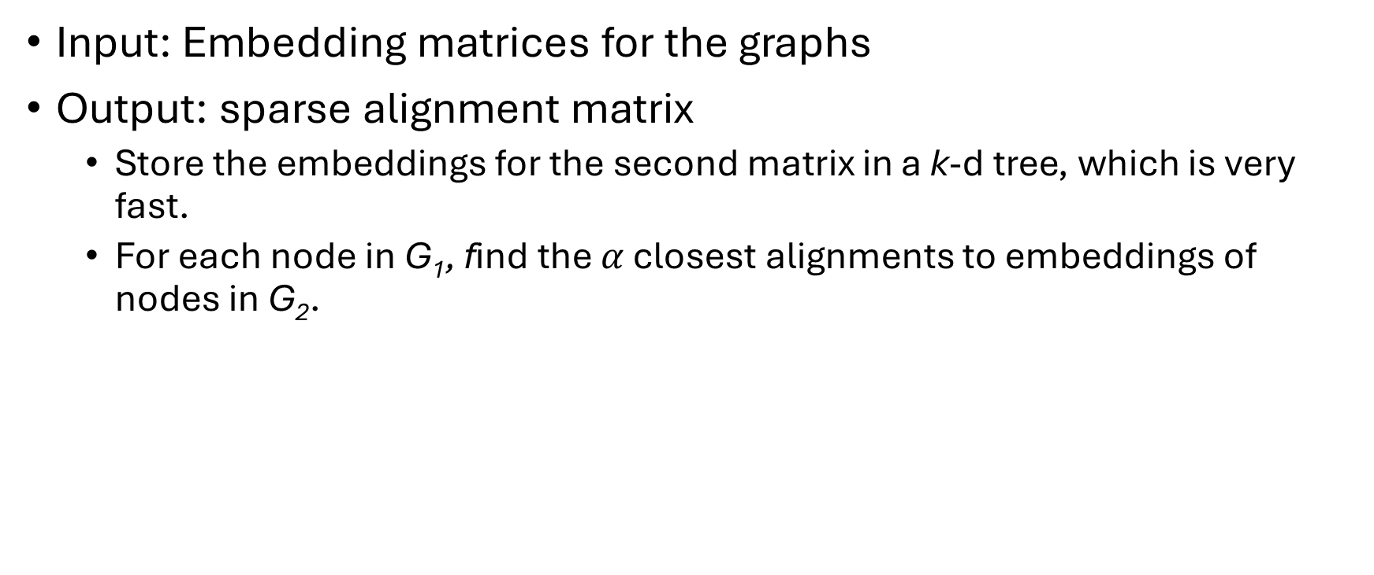
Step 3: Fast node representation alignment
Input: Embedding matrices for the graphs
Output: sparse alignment matrix
Store the embeddings for the second matrix in a k-d tree, which is very fast.
For each node in G₁, find the $α$ closest alignments to embeddings of nodes in G₂.

